Slide 1
Lariat Fleet Planning

Slide 2
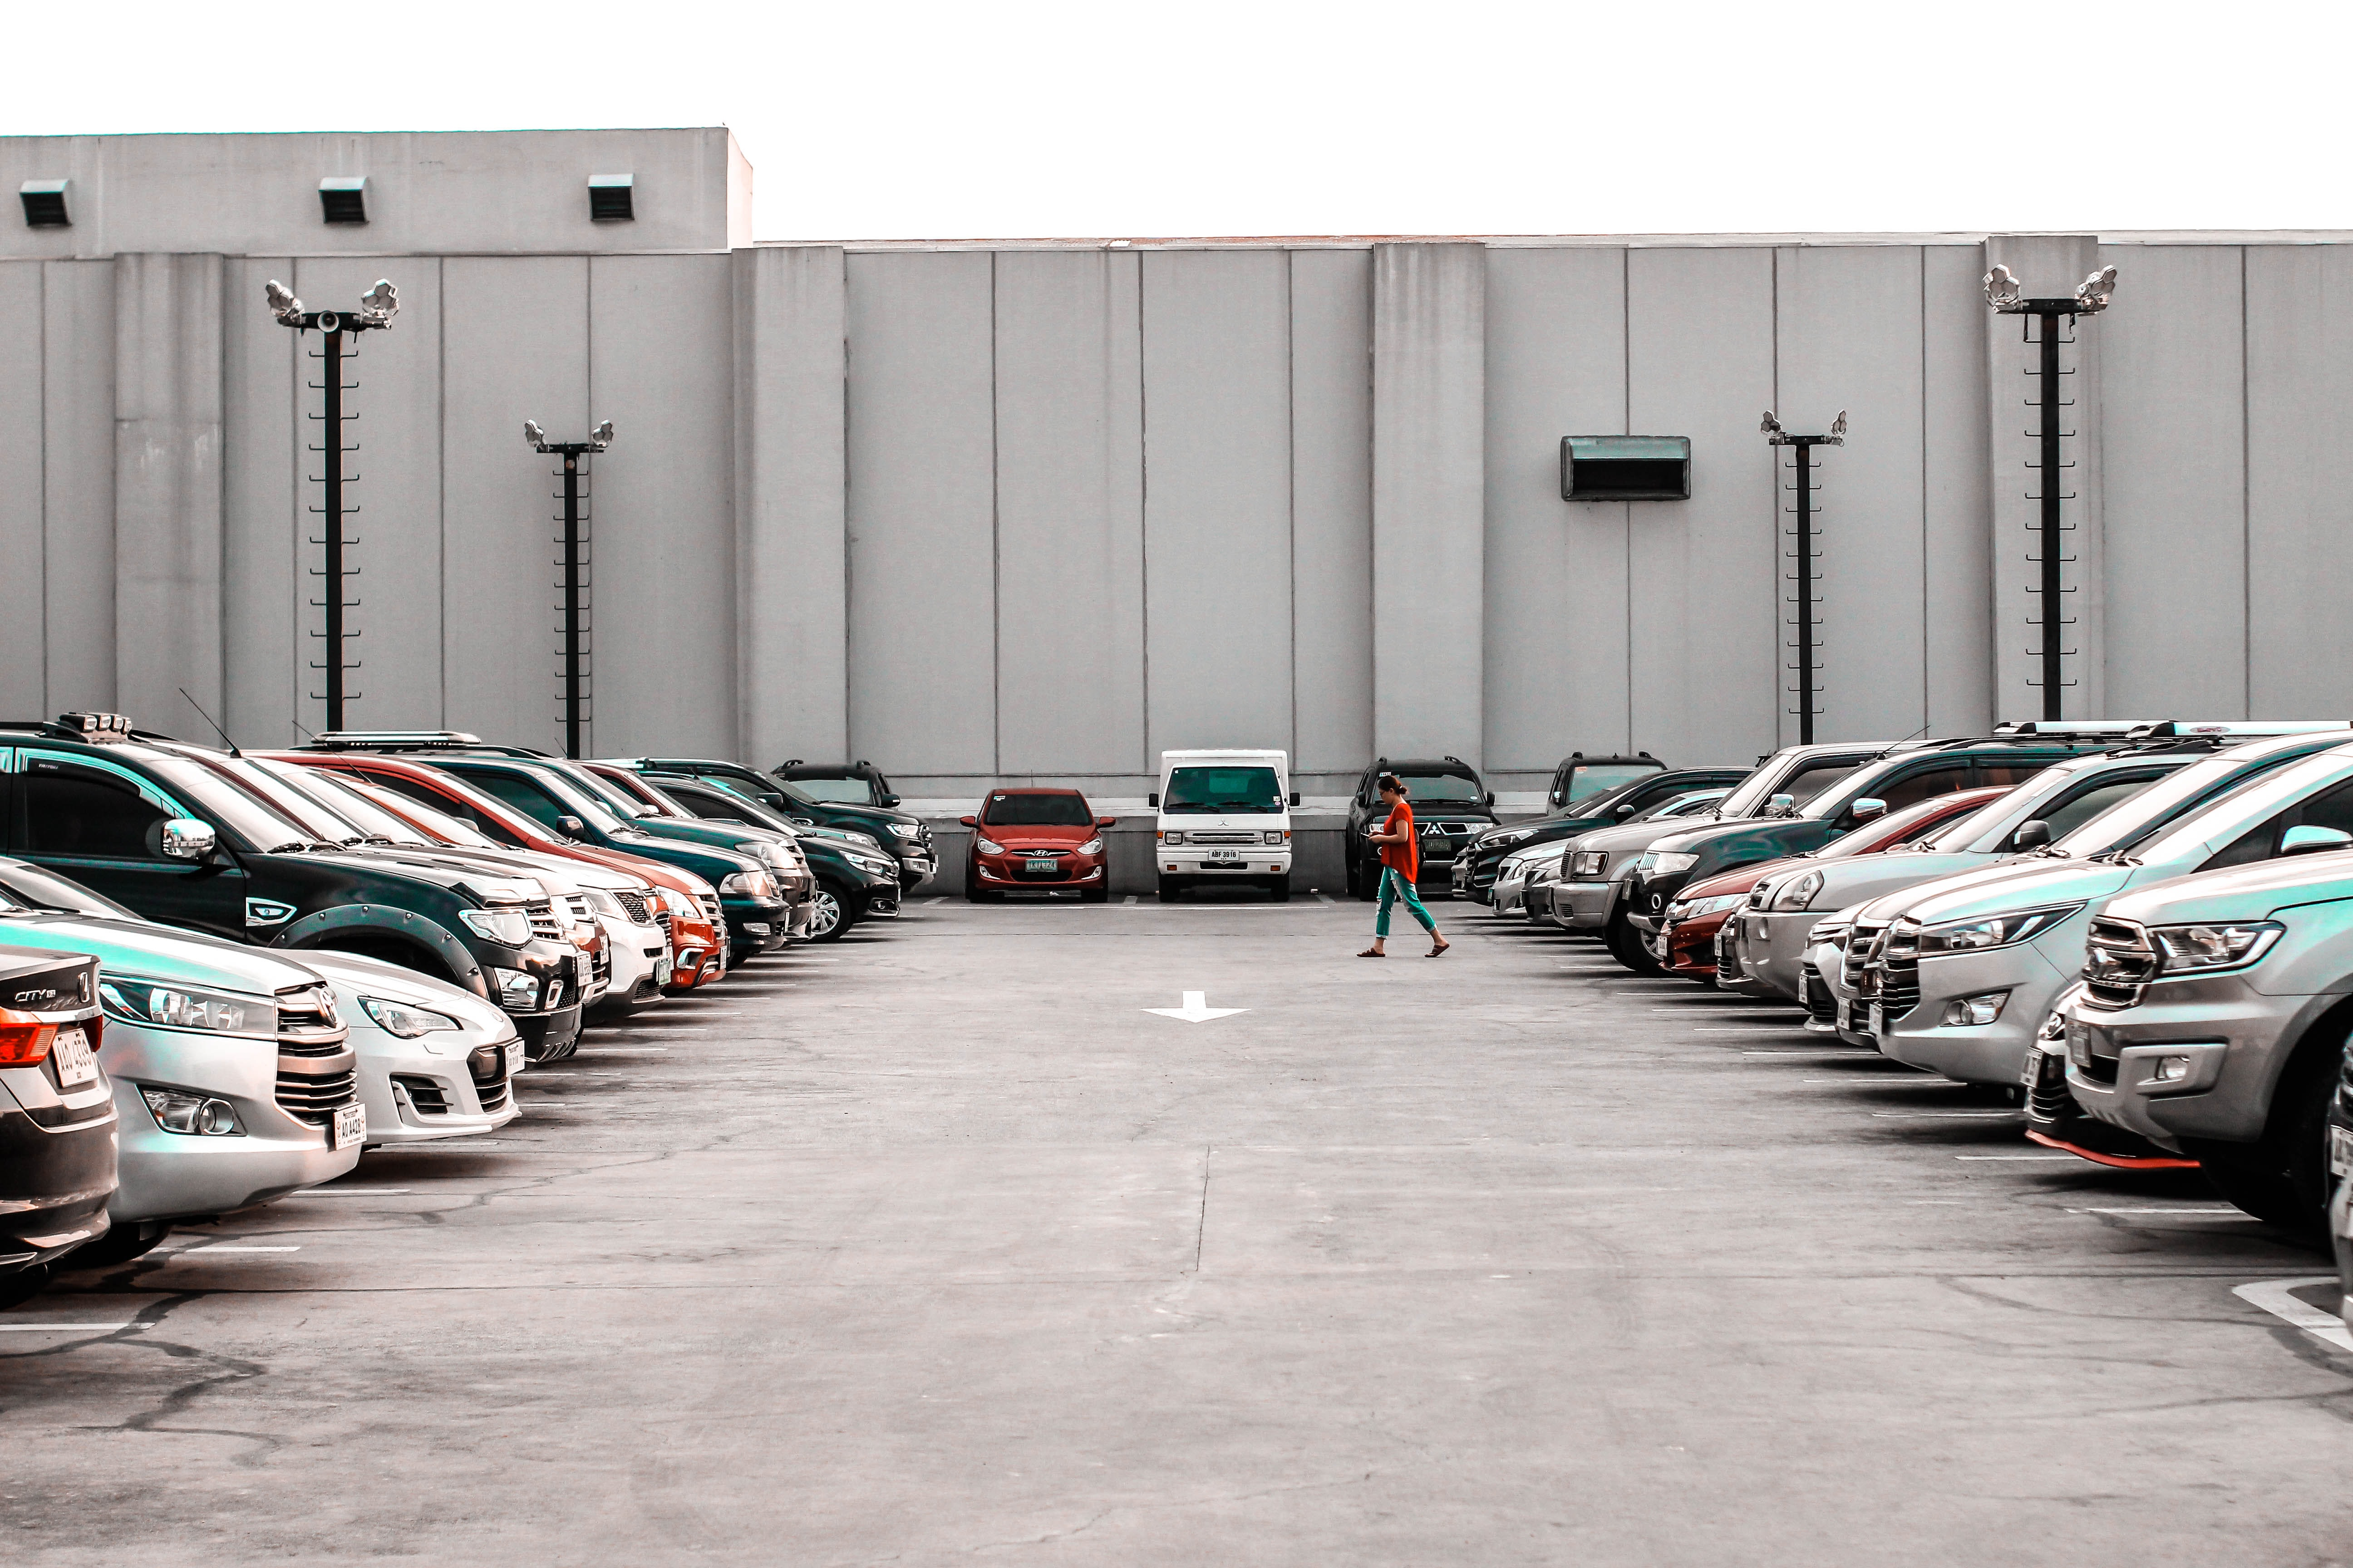
4000 Vehicles

Slide 3
Remove Bottom Performing Vehicles

Slide 4
Increase Fleet Count with Popular Models
1.2%

Slide 5
Replace Bottom Performing with Most Popular
0.3%

Slide 7
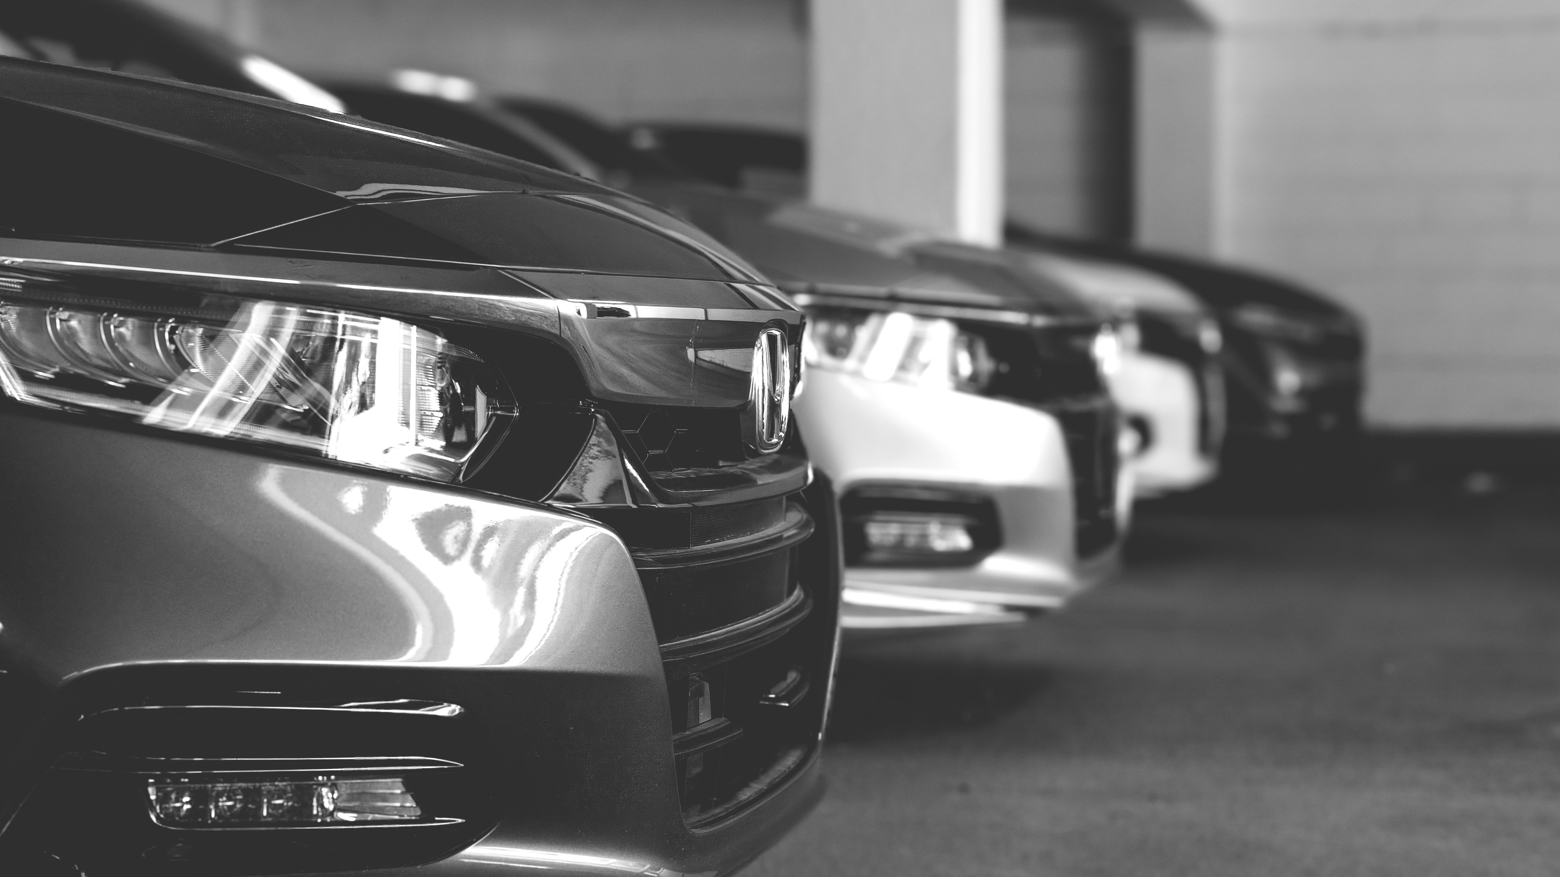
Thank You!

